Slide 1
OPTICAL ILLUSIONS

Slide 2
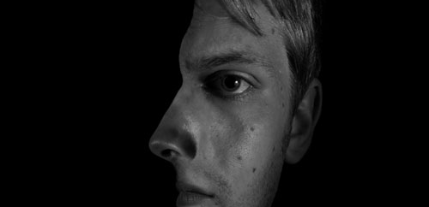
TWO FACED

Slide 3
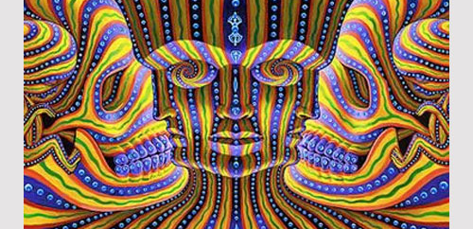
SEVEN FACES

Slide 4
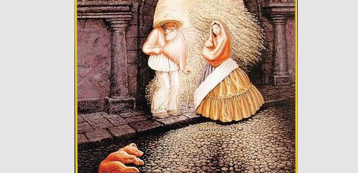
MAN AND THE THREE IMAGES

Slide 5
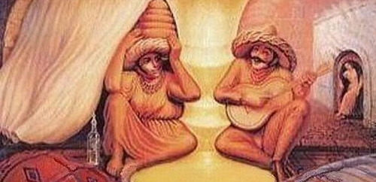
SALVADOR DALI

Slide 6
WHITE SPACES: CIRCLES

Slide 7
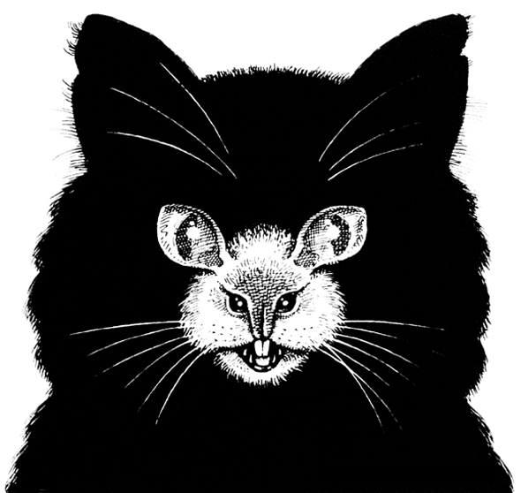
CAT-MOUSE

Slide 8
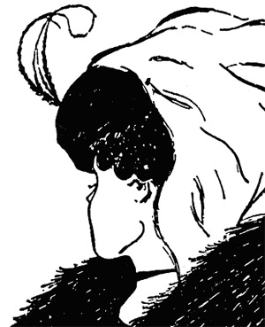
OLD WOMAN OR
YOUNG WOMAN

Slide 9
HOW MANY LEGS?

Slide 10
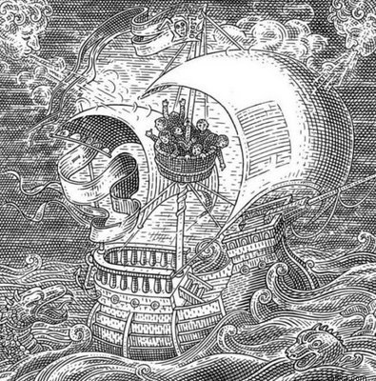
A SHIP SAILING
IN THE OCEAN
OR A SKULL?

Slide 11
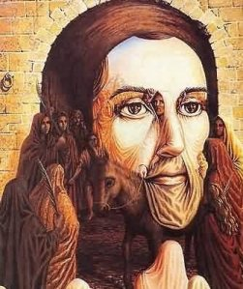
JESUS OR A
LOT OF PEOPLE
SURROUNDING HIM
ON A DONKEY?

Slide 12
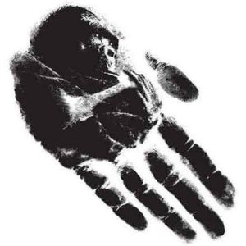
APE OR HAND?

Slide 13
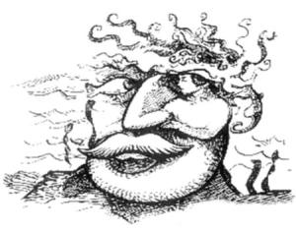
MAN OR MERMAID?

Slide 14
FOR MORE OPTICAL ILLUSIONS…
http://creativefan.com/cool-optical-illusions/
http://empathicperspectives.wordpress.com/

